Slide 1
DiaSense AI: Transforming Diabetes Care
Yeo Xiu Juan (34678307)
Rodland Aquino (34641153)
Kanagaraj Prakash (35113797)
Click on DiaSense Streamlit application now and take control of your diabetes risk with AI-powered insights!

Slide 2
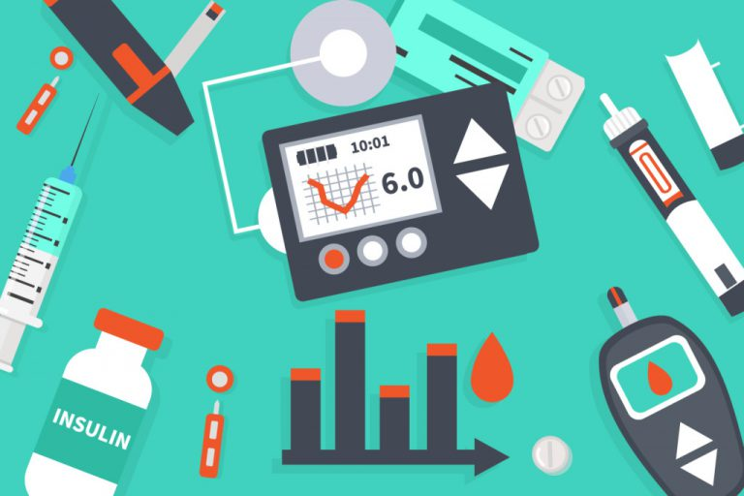
01
Introduction

Slide 3
About DiaSense
DiaSense is an AI-powered system designed to transform diabetes risk assessment.
Focuses on high-risk populations, such as the Pima Indian community.
Provides real-time, personalized risk evaluations tailored to each individual.

Slide 4

02
Significance of the problem

Slide 5
Problem Domain
Existing Studies
Overlooked Health
Risks for Women
GDM as an Emerging Public Health Concern
Modest Increase in BMI Over Time
Existing studies often fail to address the specific risks faced by women, especially those with maternal health concerns.
Research suggests that the prevalence of GDM in Pima women reflects similar trends in other ethnic groups across the U.S., indicating a broader public health issue.
Over the past 25 years, there have been modest increases in BMI across different age and sex groups, further elevating the risk of diabetes (Bashir I. A, 2019).

Slide 6
Experimental Pipeline
Data Collection
Retrieve Pima Indian Dataset from Kaggle
Data Pre-Processing
-Min-Max Scaling
-Feature Engineering (PCA)
-Train (70%)
Val (15%)
Test (15%)
Model Training
-MLP
-MLP+LR
-MLP+RF
Performance Evaluation
-ROC-AUC
-ROC-PRC
-G-Means
Compute Risk Probabilities
Youden's J statistic
to compute risk scores
Develop UI Application
Streamlit
Post-Processing
SHAP for interpretability

Slide 7

03
AI Techniques Exploration

Slide 8


Three AI Techniques Explorations
Neural Network
1. MLP
Multilayer Perceptron (MLP) is a popular machine learning algorithm, especially in artificial neural networks, known for its ability to identify complex patterns in data. It is particularly effective in handling non-linear relationships between input features and output predictions.
Ensemble Learning : Soft Voting to build two hybrid model
2.MLP + LR :
A Voting Classifier combines multiple models, usually through majority voting, to enhance prediction accuracy. By integrating the non-linear power of MLP and the linear classification strength of Logistic Regression (LR), it creates a more robust, flexible model that can handle complex data while retaining transparency through the LR component.
3. MLP + RF
The MLP + RF ensemble combines MLP's ability to model complex, non-linear patterns with RF's strength in handling categorical and continuous data, improving accuracy, enhancing interpretability, and increasing stability by mitigating MLP's tendency to overfit and handling noisy data.

Slide 9

04
Assessing AI Techniques

Slide 10
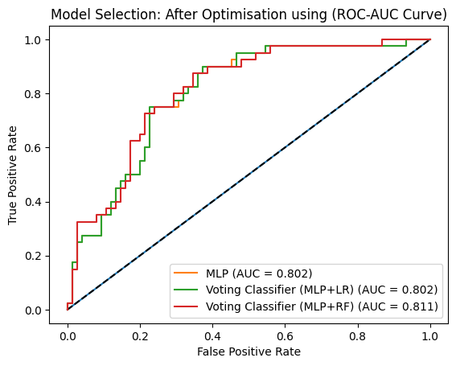
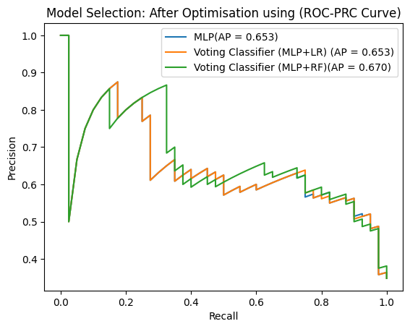
ROC-AUC & ROC-PRC Comparison across 3 models
One of the key considerations in model selection is generalization performance, ensuring that the model performs well not only on training data but also on unseen test data. While MLP+RF exhibited higher AUC-ROC (81%) and AUC-PRC (67%), it struggled with lower specificity (70%) and higher error rates (27%), indicating a higher likelihood of false positives. This suggests that MLP+RF, despite capturing complex patterns, may have overfitted to the training data, leading to reduced reliability on new samples.
In contrast, MLP+LR demonstrated a more balanced trade-off between complexity and interpretability.

Slide 11

05
Final Model Evaluation : MLP + LR

Slide 12
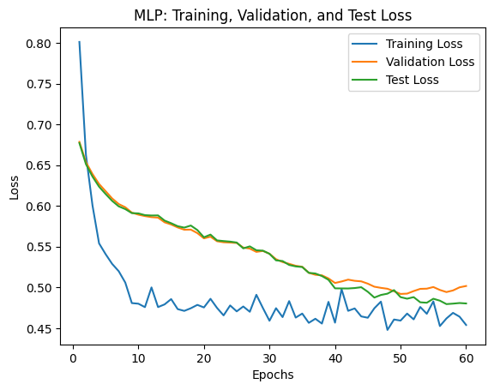
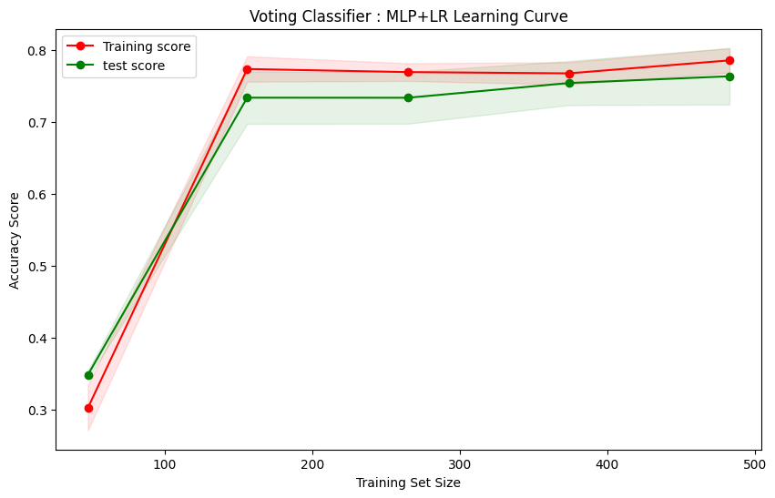
Learning Curve
After epochs 62, the model reaches validation loss of 0.50, test loss 0.47 and test accuracy of 77%.
The Voting Classifier (MLP+LR) achieves a testing accuracy of approximately 0.77 and training score of around 0.80 with a training set size of 500.

Slide 13
BenchMark Accuracy & AUC-ROC
The average accuracy of deep learning models on similar datasets is around 88%, resulting in a performance gap of 11%.
In contrast to ROC-AUC, our model showed a 5% gap compared to other approaches. It is worth noting that the PID dataset has multiple versions, some of which contain missing values, requiring imputation. However, the version we used, sourced from Kaggle, had no missing values.

Slide 14
Performance Index : Efficiency Metrics
Training Time
0.03 Seconds
Inference Time
0.000 Seconds
Energy Consumption Index
14.48
Scalability Index
0.00
Joules
Seconds/ Sample

Slide 15

06
UI Applications

Slide 16
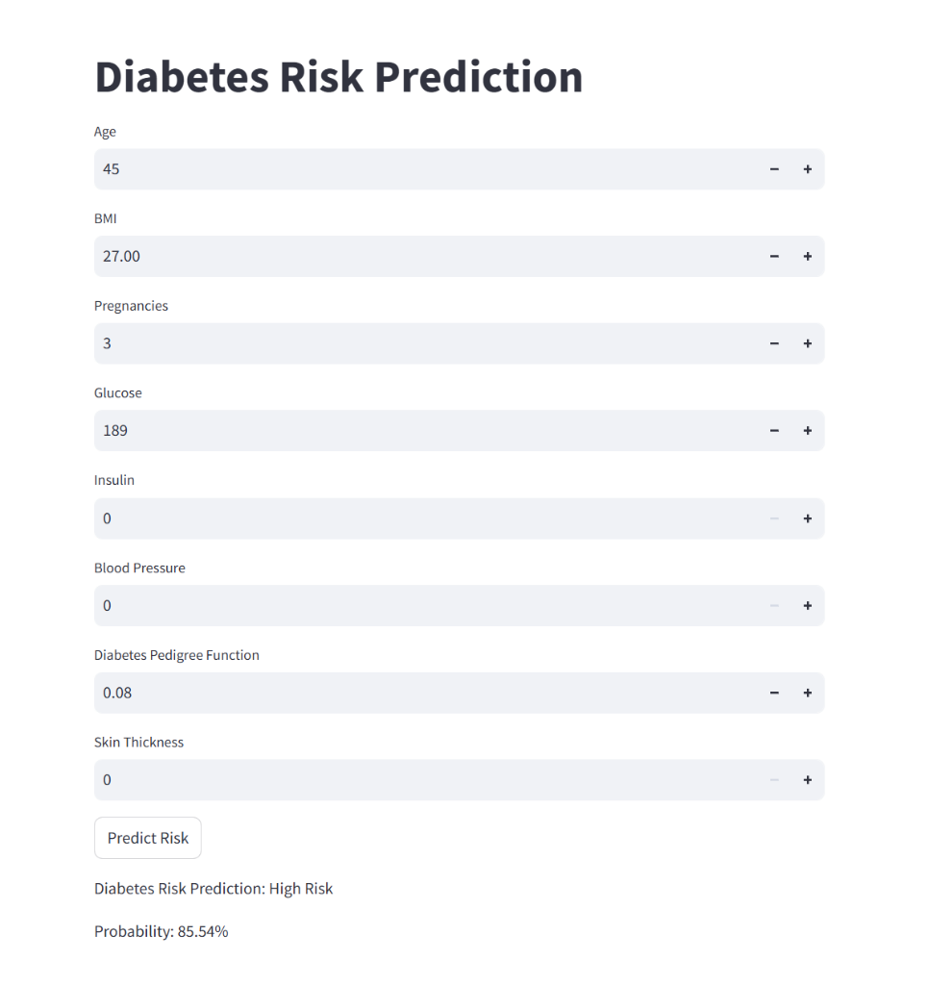
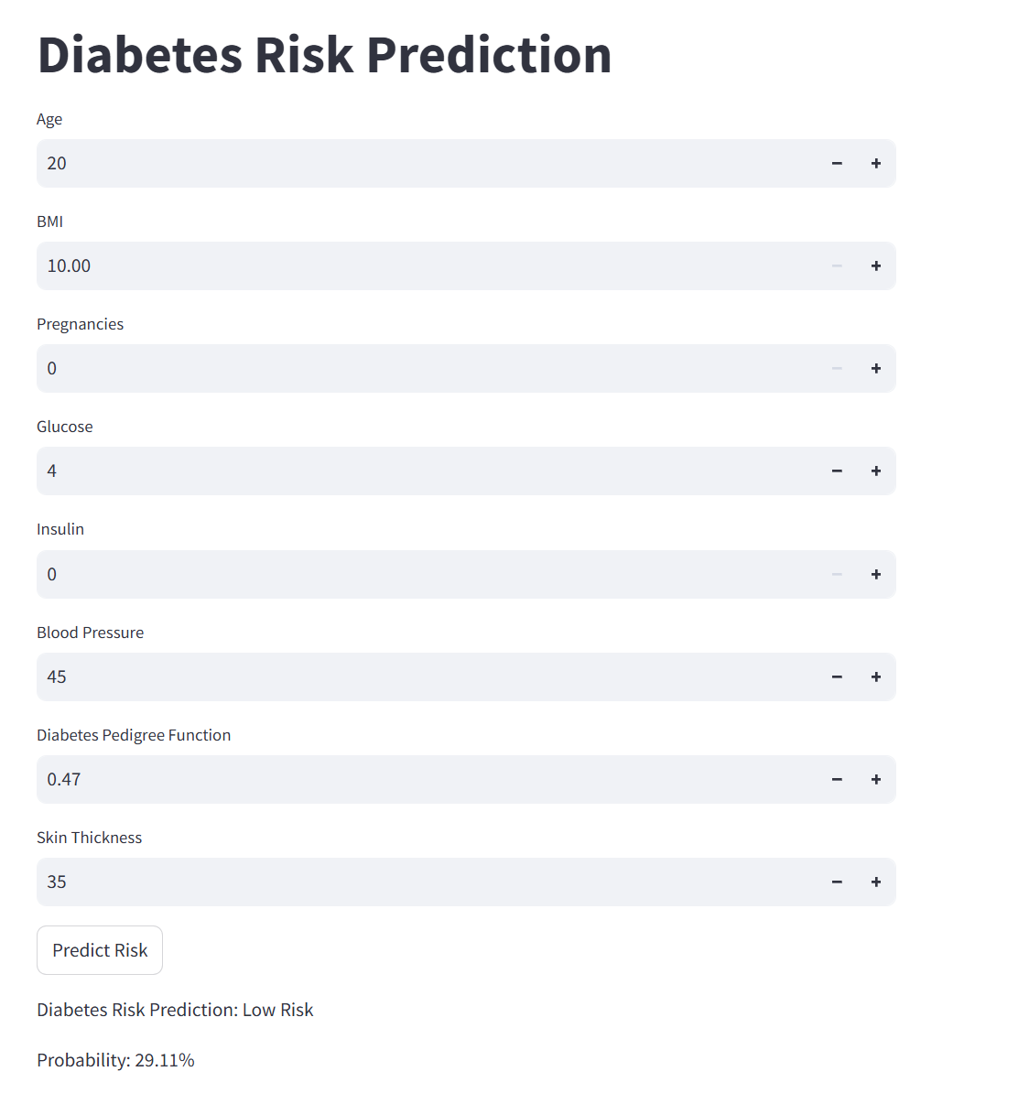
Click to Dia sense: Streamlit Application to understand more on your Diabetes risk.
High Risk
Low Risk
Notes:
High Risk:
A Pima Indian woman aged 45, with a Diabetes Pedigree Function (DPF) of 0.08 and a glucose level of 189 mg/dL, presents a high risk of early-onset diabetes. Several clinical indicators support this assessment:
Elevated Glucose Levels (189 mg/dL) – This measurement significantly exceeds the normal fasting glucose range (70–99 mg/dL) and surpasses the prediabetic threshold (100–125 mg/dL), suggesting hyperglycemia, a primary indicator of diabetes mellitus.
Low Diabetes Pedigree Function (DPF) (0.08) – While a higher DPF is associated with a strong familial predisposition to diabetes, a low DPF does not preclude the risk of developing the condition. Instead, this finding suggests that non-genetic factors, such as environmental influences and lifestyle choices, may play a predominant role in disease progression.
Maternal Age (45) and Pregnancy History (3 pregnancies) – Epidemiological research indicates that women over the age of 45 who have experienced multiple pregnancies are at an increased risk of developing type 2 diabetes. This correlation is partly due to the physiological changes associated with pregnancy, including gestational diabetes, which can contribute to long-term metabolic dysregulation.
Absence of Measurable Insulin (0) and Blood Pressure (0 mmHg) – The reported absence of insulin secretion suggests potential pancreatic beta-cell dysfunction, impairing glucose regulation. Additionally, an extremely low or unrecorded blood pressure measurement may indicate an underlying circulatory or metabolic disorder, further exacerbating the likelihood of diabetes onset.
Based on these clinical parameters, the Diasense AI system estimates an 85.54% probability of diabetes for this individual, highlighting the need for immediate medical evaluation and targeted interventions to mitigate disease progression.
Low Risk: For a Pima Indian woman aged 20 with the given health parameters, the Diasense AI system predicts a low diabetes risk (29.11%). The implications of these factors are as follows:
Young Age (20 years old) – Youth is a protective factor against type 2 diabetes, as metabolic function and insulin sensitivity tend to be more efficient in younger individuals.
Low BMI (10) – A BMI of 10 is extremely low, potentially indicating underweight status or malnutrition. While obesity is a major risk factor for diabetes, being severely underweight may suggest other health concerns, including nutritional deficiencies.
No Pregnancies (0) – The absence of pregnancies eliminates any risk related to gestational diabetes, a condition that can increase susceptibility to type 2 diabetes later in life.
Extremely Low Glucose (4 mg/dL) – This value is abnormally low, likely an error, as normal fasting glucose ranges from 70 to 99 mg/dL. If accurate, such a low glucose level could indicate hypoglycemia, which is not typically linked to diabetes but may suggest other metabolic or endocrine disorders.
Insulin = 0 – The lack of measurable insulin is concerning, as it suggests a possible issue with insulin production. However, in the absence of hyperglycemia, this may not immediately indicate diabetes.
Blood Pressure (45 mmHg) – This is significantly below the normal range (typically 90/60 mmHg or higher). If accurate, such a low blood pressure might indicate hypotension, which could be due to dehydration, malnutrition, or another underlying condition.
Moderate Diabetes Pedigree Function (DPF = 0.47) – A moderate DPF suggests a moderate genetic predisposition to diabetes, meaning family history could play a role, but environmental and lifestyle factors remain critical determinants.
The Diasense AI system predicts a low diabetes risk (29.11%) for this individual. However, the extremely low BMI, glucose, and blood pressure levels may indicate potential nutritional deficiencies or underlying metabolic disorders that warrant medical attention. Despite the low risk of diabetes, maintaining a balanced diet, regular physical activity, and routine health check-ups is essential for long-term metabolic health and overall well-being.

Slide 17

07
Key Findings, Limitation, Future Research & Conclusion

Slide 18
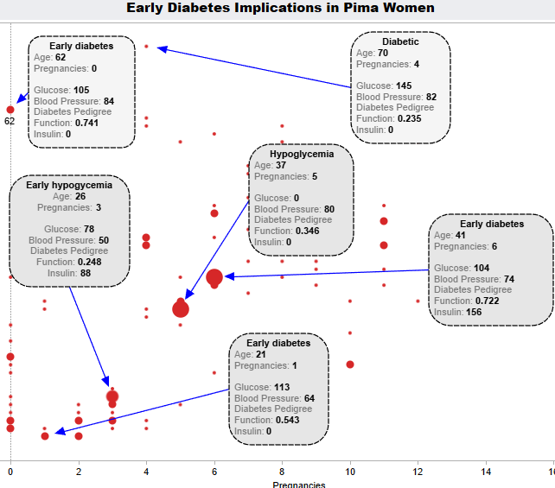
Key Findings
Progression Risk: Early diabetes cases could progress to full diabetes over time, especially in individuals with high genetic risk (DPF ≥ 0.7) and beta-cell dysfunction (insulin = 0 at older ages).
Metabolic Dysfunction: The drop from high insulin (156 µU/mL at age 41) to 0 (at age 62 and 70) suggests a shift from insulin resistance to insulin deficiency, a common progression in Type 2 Diabetes.
Hypoglycemia Risk: Cases with low glucose levels (78 mg/dL and 0 mg/dL) indicate potential risks of severe hypoglycemia, which could lead to serious health complications if not managed properly.

Slide 19
Limitation & Future Research
Future Research
Limitations
Advanced Hybrid and Ensemble Methods
Fuzzy Logic Integration: Incorporating fuzzy logic would allow the model to handle uncertainty and imprecise data, particularly for variables like glucose levels that fluctuate continuously.
Deep Belief Networks (DBN): Combining MLP with DBN could enhance feature extraction, leading to better data represent
2.Privacy-PreservingLearning Techniques
Federated Learning: This approach enables model training across decentralized data sources without transferring sensitive patient information, ensuring compliance with privacy regulations (e.g., GDPR, HIPAA) while maintaining model performance.
Statistical Methods vs. Expert Knowledge in Diabetes Prediction
Current Model using Youden's J statistic to estimate the probability of Diabetes risk factors.
If there a expert domain, Bayesian networks capture to uncertainty and interactions between BMI, Glucose,BP & etc.

Slide 20
Conclusions
The MLP+LR model achieved an AUC-ROC of 0.84, along with competitive G-Means and AUC-PRC scores of 75%, demonstrates its potential in enhancing the accuracy and reliability of predictive modeling.
As the field of AI in healthcare continues to evolve, DiaSense represents a significant step forward in improving patient outcomes. Furthermore, its development is grounded in humanized AI, ensuring that its implementation prioritizes ethical principles, fairness, transparency, and respect for individual privacy.
This work lays the foundation for AI-driven diagnostic tools in healthcare, with the potential for even greater advancements and more personalized, accessible care in the future.

Slide 21
References
Asghari Varzaneh, Z., & Hosseini, S. (2023). An Intelligent Fuzzy System for Diabetes Disease Detection using Hawks Optimization. Artificial Intelligence and Data Mining, 11(2), 187-194. https://doi.org/10.22044/JADM.2023.12383.2383
Asha, V., Lamani, M;R., Padmaja, K., & Gondhale, T. A. (2024). Enhancing Diabetes Prediction Accuracy with AdvanSVM: A Machine Learning Approach Using the PIMA Dataset. Seybold Report Journal, 19(05), 51-72. https://seyboldpublications.com/wp-content/uploads/2024/05/Asha-V.pdf
Bashir I. A, M. A. A., Banu R, Elyas T. B. (2019). Significance of Health Related Predictors of Diabetes in Pima Indians Women. . 7(2). https://doi.org/http://dx.doi.org/10.12944/CRNFSJ.7.2.05
Butt, U. M., Letchmunan, S., Ali, M., Hassan, F. H., Baqir, A., & Sherazi, H. H. R. (2021). Machine Learning Based Diabetes Classification and Prediction for Healthcare Applications. J Healthc Eng, 2021, 9930985. https://doi.org/10.1155/2021/9930985
Choudhury, Z. (2023). Integrating Random Forest, MLP and DBN in a Hybrid Ensemble Model for Accurate Breast Cancer Detection. https://doi.org/10.31219/osf.io/sdjqf
Hajian-Tilaki, K. (2013). Receiver Operating Characteristic (ROC) Curve Analysis for Medical Diagnostic Test Evaluation. Caspian J Intern Med, 4(2), 627-635. https://pmc.ncbi.nlm.nih.gov/articles/PMC3755824/
Health., H. (2024). Type 2 diabetes mellitus. Retrieved 30 January 2025 from https://www.health.harvard.edu/diseases-and-conditions/type-2-diabetes-mellitus-a-to-z
Kaggle. (2016). PIMA Indians Diabetes Database. Retrieved January 27,2025 from https://www.kaggle.com/datasets/uciml/pima-indians-diabetes-database
Streamlit. (2025). Diabetes Risk Prediction. https://ict619diasense-bmoqpf3atdcrw7ush9podz.streamlit.app/
Tumgoyev, Y. (2022). Diabetes prediction using Multilayer Perceptron NAZARBAYEV UNIVERSITY]. https://nur.nu.edu.kz/server/api/core/bitstreams/88aee630-02ae-40d9-a299-f58efcfc097e/content

